Slide 1
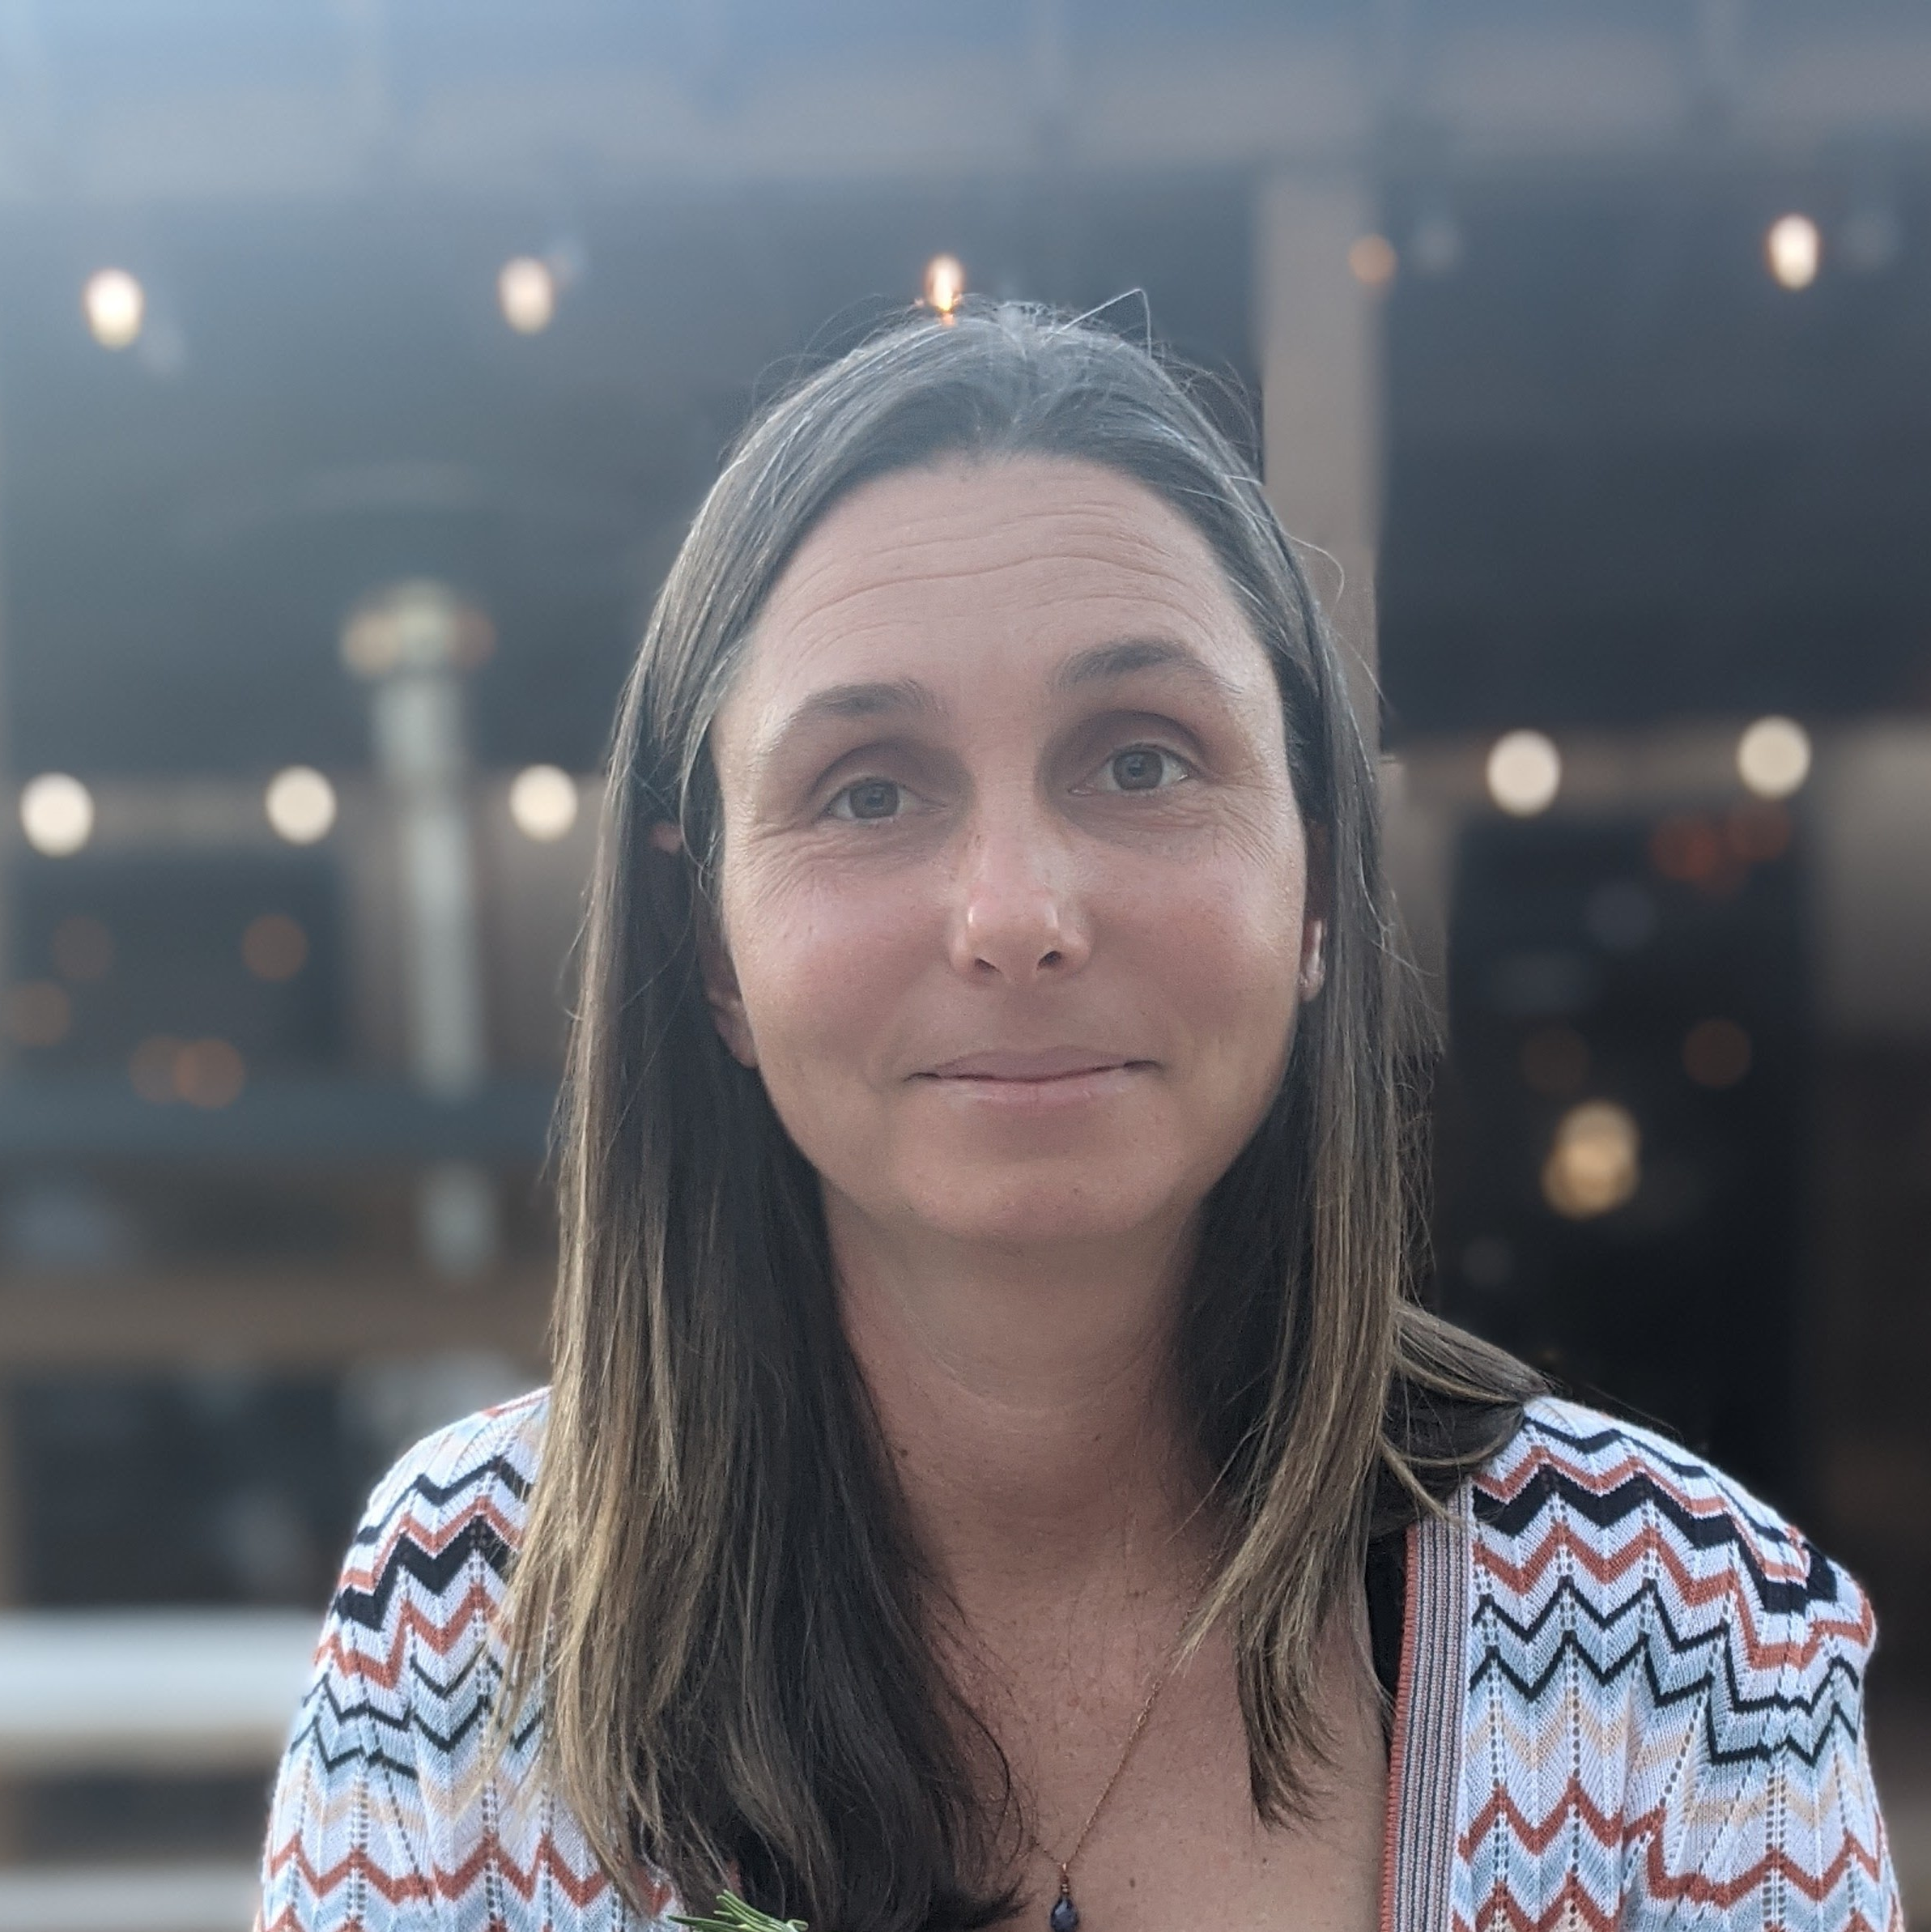
Katy Steen Manager — Acceleration
Email
Katy.Steen@thebridge.com
Location
Austin, Texas
Mobile
(512) 876-5767
Katy joined The Bridge in October 2023. She has previously worked as a Project and Program Manager for several companies across multiple industries where she has led projects (both large and small) spanning IT, customer support, process improvement, and others.
EXPERIENCE
Industry Experience
Financial Services | Technology | Automotive | Consumer Goods and Services
Aspiration | Financial Services
Lead Consumer Vertical Program consisting of 3-5 Agile teams, managing overall scope, schedule, risk management, and Agile processes to ensure project completion and program success
Implement improvements in team structure and standards to navigate multiple company reorganizations
Owned C-Suite driven program initiatives with high levels of visibility and sensitivity
Drove collaboration with Program Management Organization to manage/align individual workstreams and improve processes, tool usage, and reporting across all Tech Teams
Selected by Leadership to lead strategic projects with cross functional team to align business needs and transparency for a rapidly-changing, remote workforce
Wholefoods Market | Consumer Goods and Services
Consistently engaged with capacity planning and process improvement initiatives that enhance project status visibility, tool usage, and reporting automation
Generated and gained alignment on program-level processes and tool sets to increase reporting automation and standardization, created stability and increased efficiency for the team, and ensured team effectiveness and reliability to our business partners
Proactively responded to critical situations with accurate analysis, problem breakdown, option assessment, and clear communication and/or escalation with the necessary stakeholders
Facilitated Program decision-making regarding scope and schedule including providing guidance on negotiations of competing priorities/interruptions on behalf of the team
Utilized strong, positive relationships with teams and leadership to turn large ambiguous executive level asks into clear deliverables with practical and achievable requirements
BACKGROUND
Functional Skills
Project Management, Program Management, Change Management, Strategic Planning, Process Improvement, Portfolio Management, Roadmaps, Agile Methodologies, Operations Management, Customer Engagement
Qualifications
Certified Scrum Master

Slide 2

Email
Katy.Steen@thebridge.com
Location
Austin, Texas
Mobile
(512)876-5767
Katy joined The Bridge in October 2023. She has previously worked as a Project and Program Manager for several companies across multiple industries where she has led projects (both large and small) spanning IT, customer support, process improvement, and others.
Katy Steen Manager
Acceleration

Slide 3









 | USE OVER DARK BACKGROUND | USE OVER LIGHT BACKGROUND
STRATEGY & ADVISORY
DATA & AI
EXPERIENCES
CLOUD & PRODUCT
ACCELERATION

